Slide 1
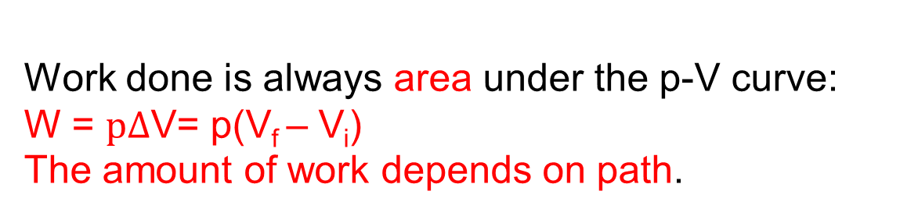
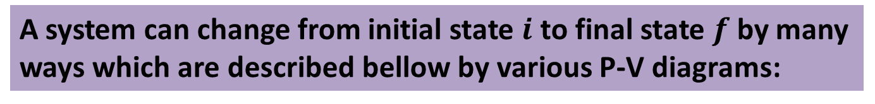
Path dependent work done in terms of p-V diagram:
A system can change from initial state $i$ to final state $f$ by many ways which are described bellow by various P-V diagrams:
Work done is always area under the p-V curve: W = $p∆$V= p(V_{f} – V_{i}) The amount of work depends on path.

Slide 2

A system can change from initial state $i$ to final state $f$ by many ways which are described bellow by various P-V diagrams:
1.
Here, the pressure decreases as volume increases.
So, the work done is positive.

Slide 3
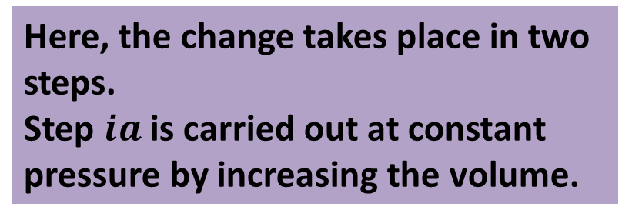

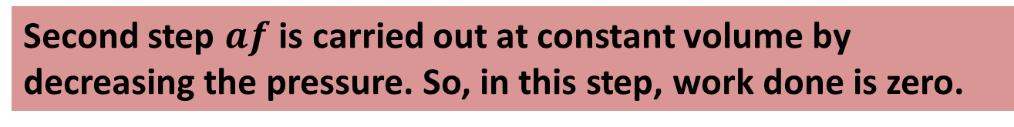
2.
Here, the change takes place in two steps.
Step $ia$ is carried out at constant pressure by increasing the volume.
So, positive work is done in this step.
Second step $af$ is carried out at constant volume by decreasing the pressure. So, in this step, work done is zero.
For the overall process, work done is positive and is carried out only during step $ia$

Slide 4
3.
Here, the change also takes place in two steps.
First step is carried out at constant volume by decreasing the pressure. So, in this step, work done is zero.
Second step is carried out at constant pressure by increasing the volume. So, positive work is done in this step.
For the overall process, work done is positive and is carried out only during the second step.

Slide 5
4.
Here, the pressure increases as volume decreases.
So, the work done is negative.

Slide 6
Here, the system is taken from some initial state i to some other state f and then back to i. The net work done by the system during the cycle is the sum of the positive work done during the expansion and the negative work done during the compression.
5.
The net work is positive because the area under the expansion curve (i to f ) is greater than the area under the compression curve (f to i).

Slide 7
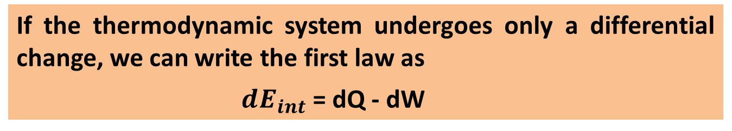
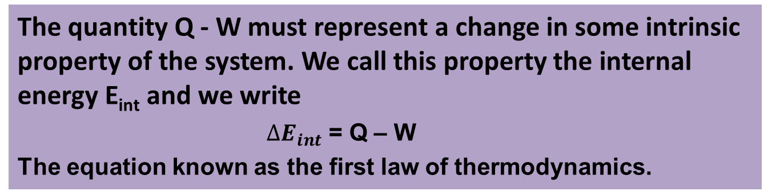
When a system changes from a given initial state to a given final state, , both W and Q depend on the nature of the process but the quantity Q-W is the same for all process which depends only on the initial and final states, not on the process.
The quantity Q - W must represent a change in some intrinsic property of the system. We call this property the internal energy E_{int} and we write
$∆E_{int}$ = Q – W
The equation known as the first law of thermodynamics.
If the thermodynamic system undergoes only a differential change, we can write the first law as
$dE_{int}$ = dQ - dW

Slide 8
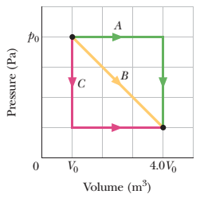
43. In Fig., a gas sample expands from V₀ to 4.0V₀ while its pressure decreases from p₀ to p₀/4.0. If V₀ = 1.0 m³ and p₀ = 40 Pa, how much work is done by the gas if its pressure changes with volume via (a) path A, (b) path B, and (c) path C?

Slide 9
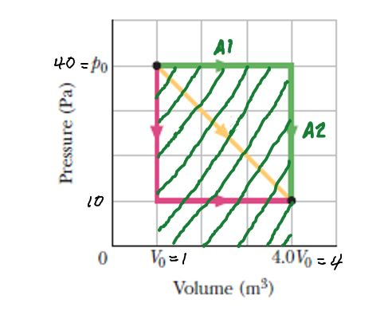
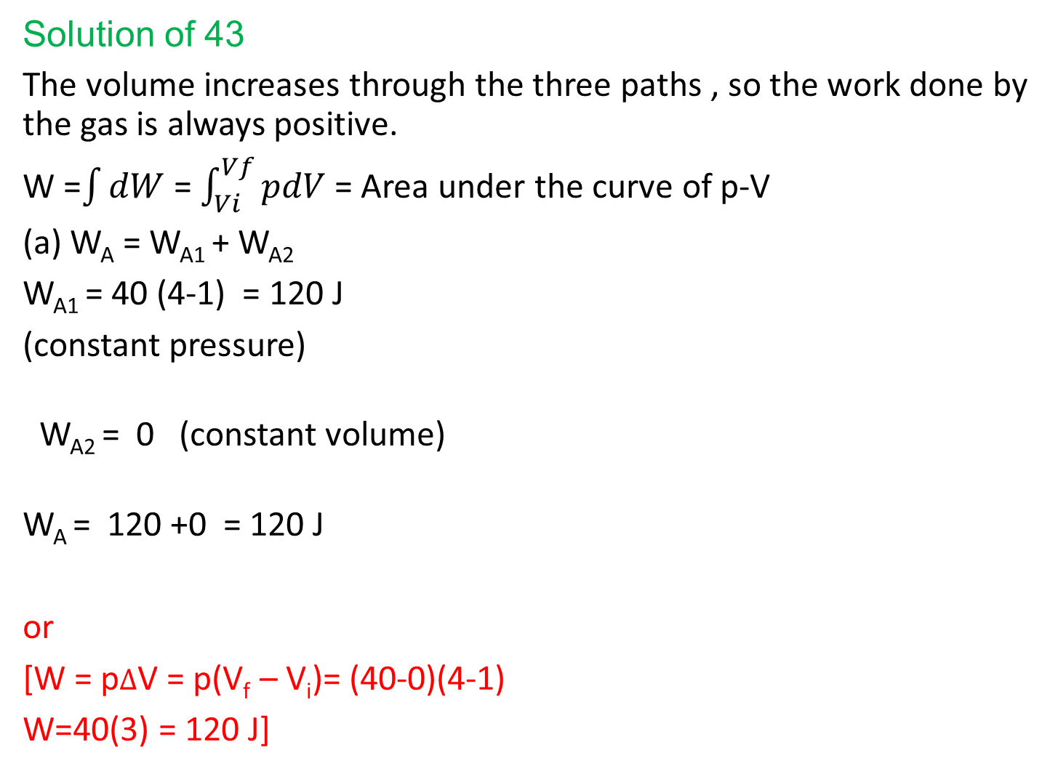
Solution of 43
The volume increases through the three paths , so the work done by the gas is always positive.
W =$\int{dW}$ = $\int_{Vi}^{Vf}{pdV }$= Area under the curve of p-V
(a) W_{A} = W_{A1} + W_{A2}
W_{A1} = 40 (4-1) = 120 J
(constant pressure)
W_{A2} = 0 (constant volume)
W_{A} = 120 +0 = 120 J
or
[W = p$∆$V = p(V_{f} – V_{i})= (40-0)(4-1)
W=40(3) = 120 J]

Slide 10
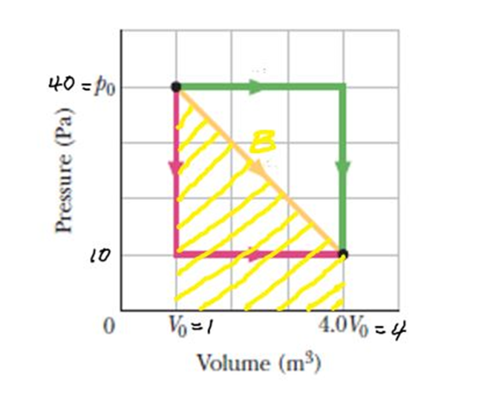
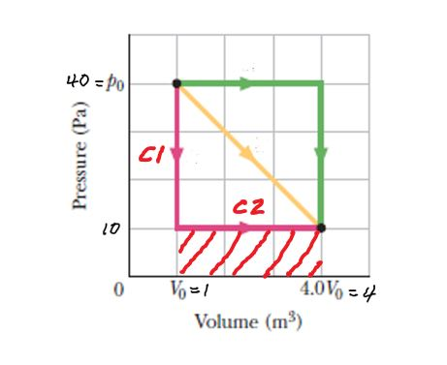
(b) The work done by the gas is the area
under the curve (yellow line)
W_{B}= ½ ×(4 - 1)(40 -10) + (4 -1)(10 - 0)
= 75 J
(c) W_{C}= W_{C1} + W_{C2}
W_{C1} = 0 (constant volume)
W_{C2} = (4-1)(10-0) = 30 J
W_{C} = 0 + 30 = 30 J

Slide 11
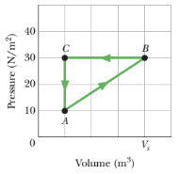
45. A gas within a closed chamber undergoes the cycle shown in the p-V diagram of Fig. The horizontal scale is set by V_{s} = 4.0 m³. Calculate the net energy added to the system as heat during one complete cycle.

Slide 12
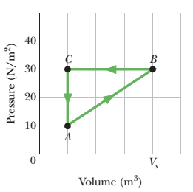
Solution:
Since for a closed cycle, ΔE_{int} = E - E = 0
1st law of thermodynamics, ΔE_{int} = Q - W
0 = Q - W
Q = W
The work done in a complete cycle is given
by the area inside the loop (triangle)
W_{net}= ½ × ( 4-1) (30-10) = 30 J
Area under the curve B to C ( compression)
Is greater than the area under the curve A
to B (expansion). So the net work done is
negative.
W _{net}= - 30 J
[or W_{net}= ½ × ( V_{f} - V_{i}) (30-10) =½ × ( 1-4) (30-10) = - 30 J]
Q = W = - 30 J
The gas (system) loses heat.

